Slide 1



MARKET PLACE FOR NORTHWEST One place to buy and sell
z
APP URL: http://52.22.24.58:8080/
Dr. Chandra Mouli Kotteti – Client/Mentor Kiran Kumar Gundapuneni – Back End Developer Hari Kiran Aluri – Back End Developer Sajida Mohammad – Front End developer Usha Pati – Front End Developer

Slide 2
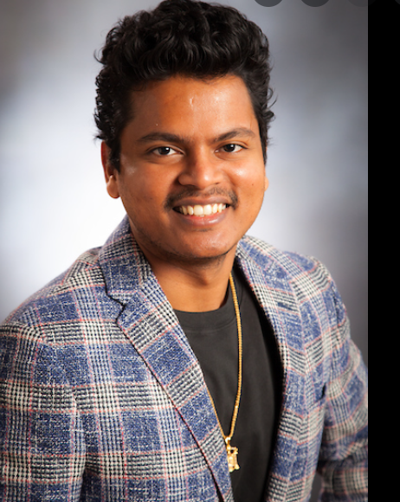
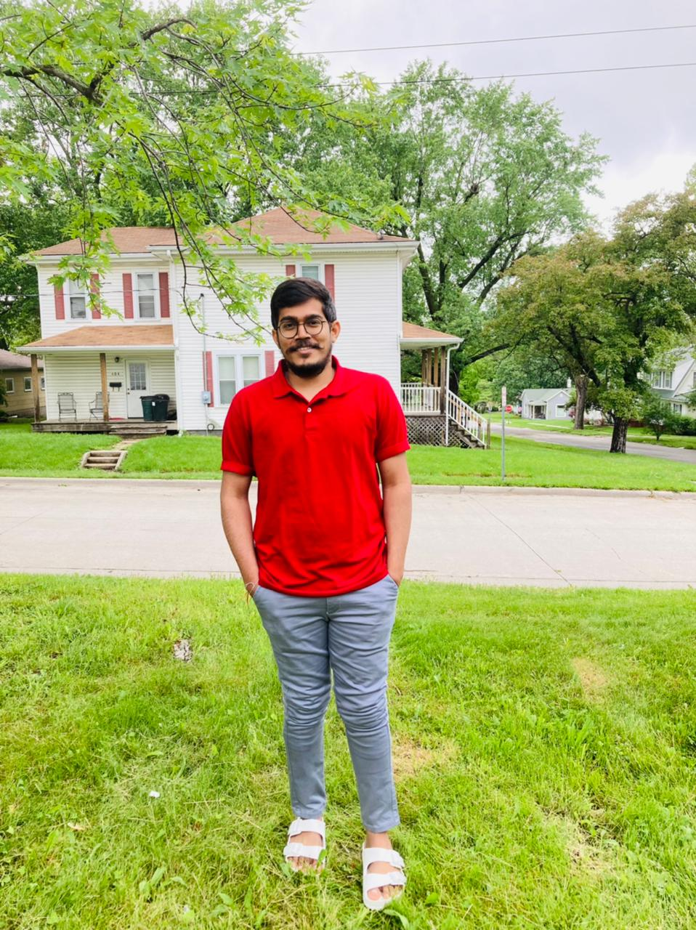
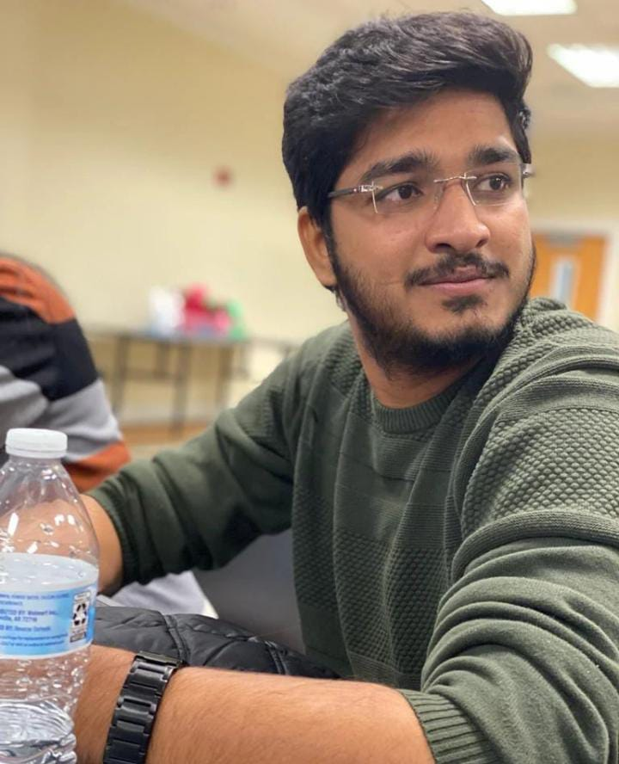
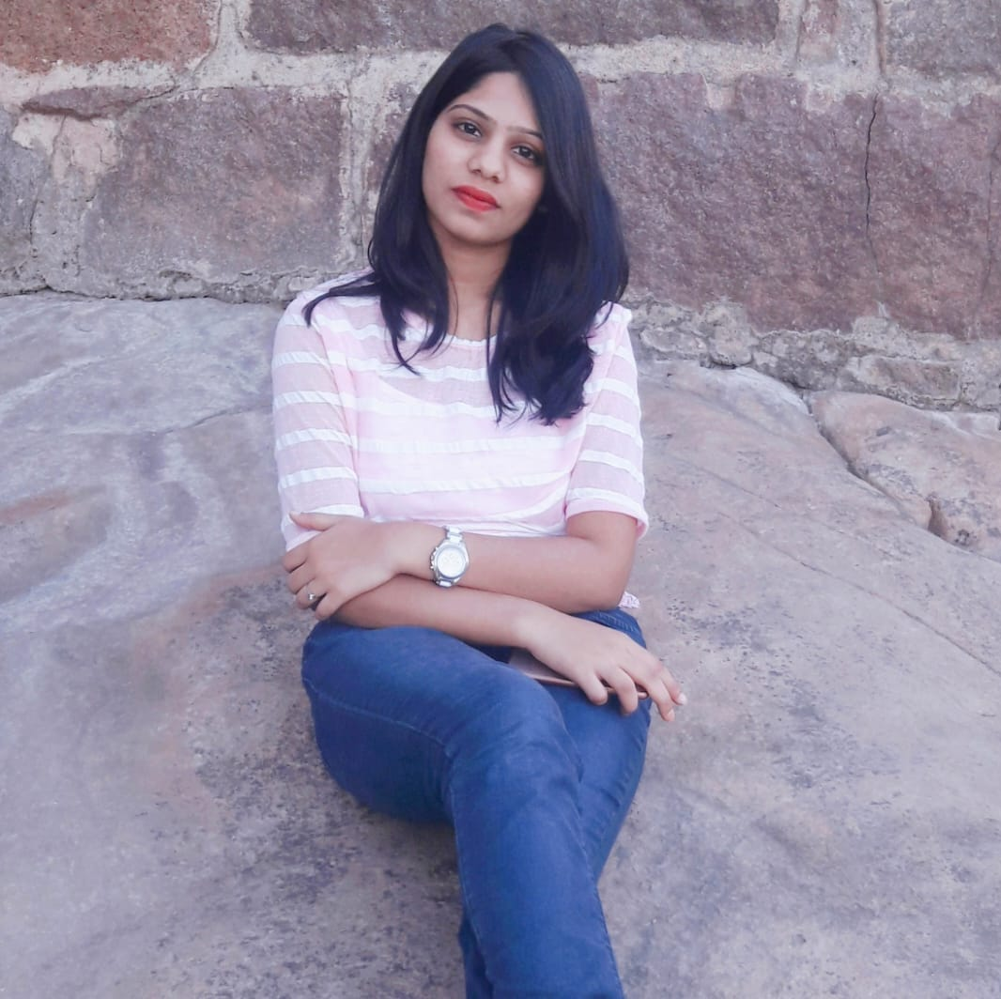
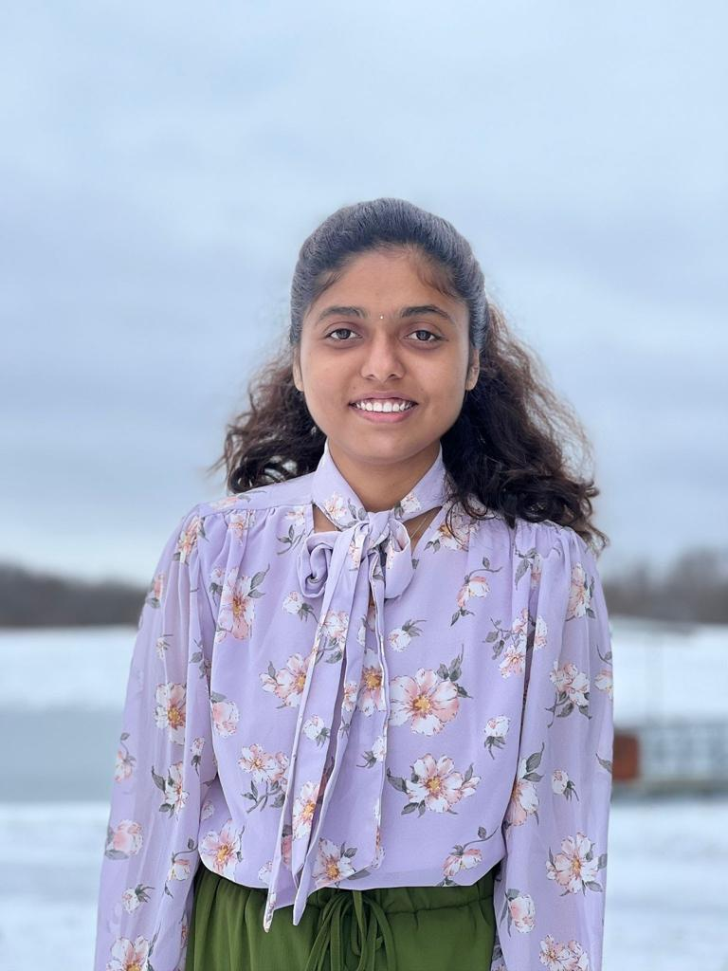
TEAM MEMBERS
DR.CHANDRA MOULI
KOTTETI
KIRAN KUMAR
GUNDAPUNENI
HARI KIRAN ALURI
SAJIDA MOHAMMAD
USHA PATI

Slide 3
TABLE OF CONTENTS
Introduction
Technical Stack
User Registration
Login Page
Buy Functionality
Sell Functionality
ADS Functionality
Update Profile
Password Reset
Lessons Learnt
Summary
References
Kiran Kumar Gundapuneni

Slide 4
INTRODUCTION
z
Market Place for Northwest Missouri State University
University students/Staff can purchase or sell the products
Easy for the students to purchase the preowned goods in a cost-efficient way
Students can make money by selling the unused products instead of trashing them
Kiran Kumar Gundapuneni

Slide 5




TECHNICAL STACK
Vue
Spring Boot
MYSQL
Selenium
Amazon EC2
Kiran Kumar Gundapuneni

Slide 6
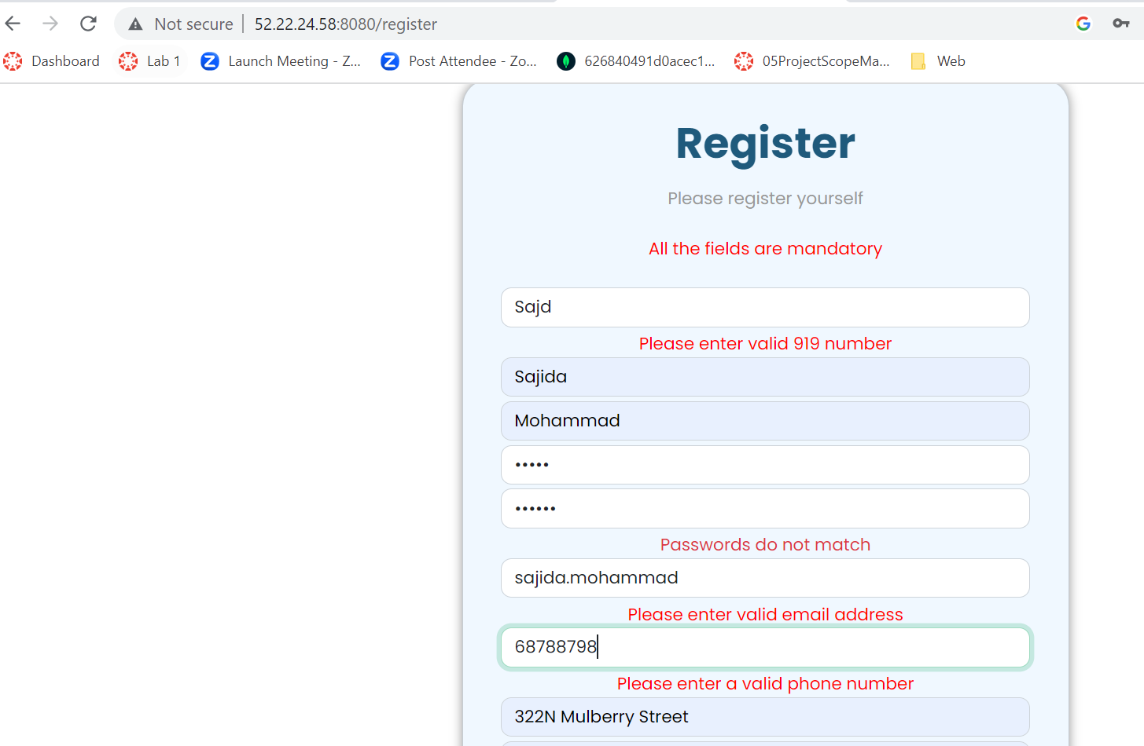
USER REGISTRATION
User registers into the application using 919 number
Email must be either @gmail or @nwmissouri.edu
Fig 1. User Registration Page
Hari Kiran Aluri

Slide 7
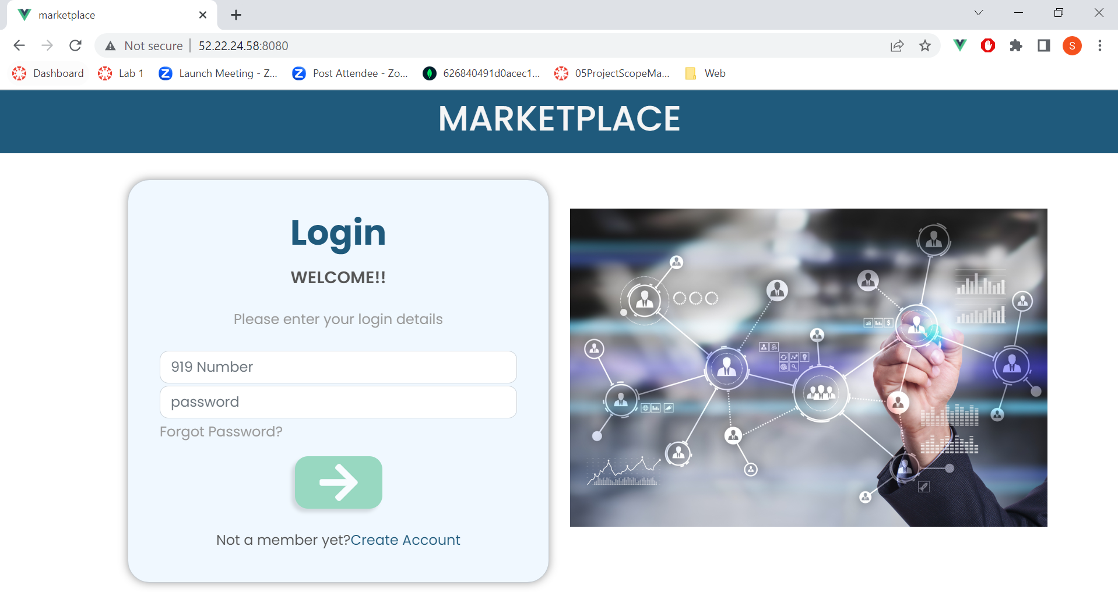
LOGIN PAGE
Fig 2. User Login Page
Hari Kiran Aluri

Slide 8
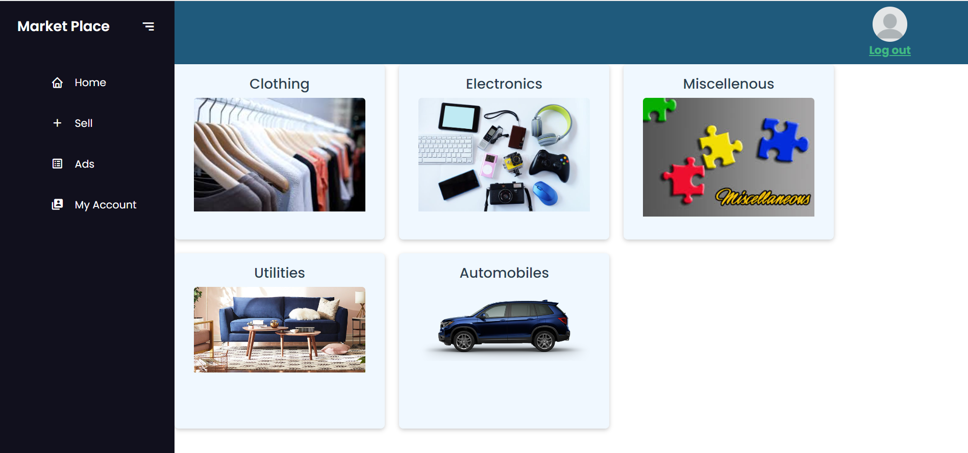
HOME PAGE
After successful login, user is directed to home page
Products are divided into five categories
Fig 3. Application Home Page
Hari Kiran Aluri

Slide 9
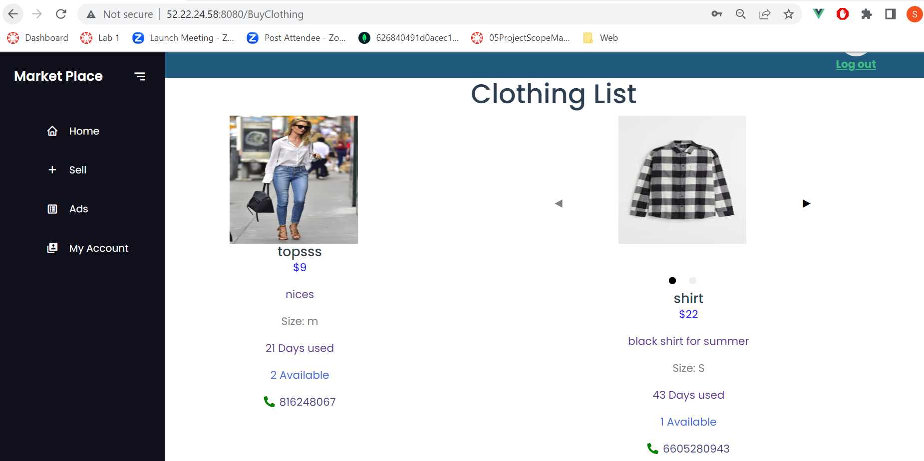
BUY FUNCTIONALITY
Price, Image and description related to the product is displayed
Seller can be contacted by the phone number provided beneath the product
Fig 4. Buy Product Page
Hari Kiran Aluri

Slide 10
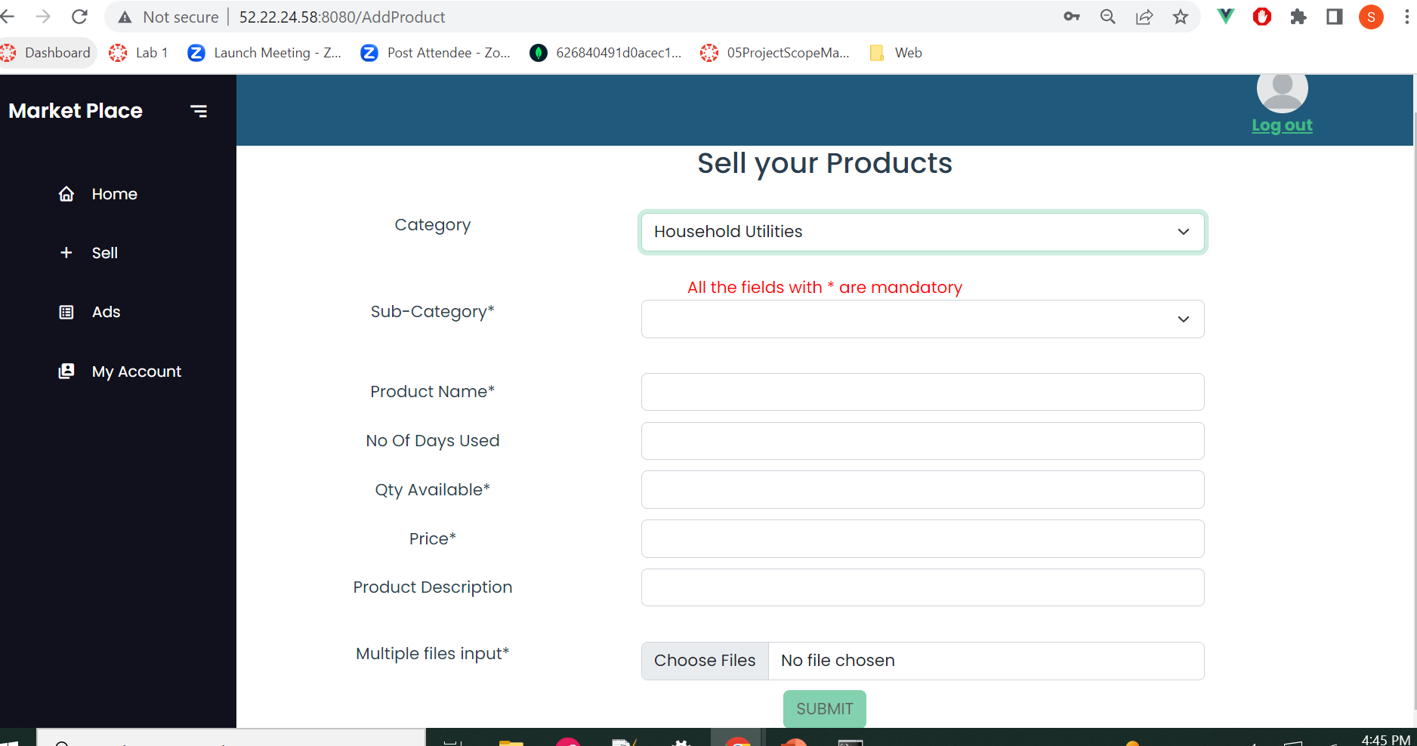
SELL FUNCTIONALITY
User can upload products that he wish to sell
Multiple images related to the product can be uploaded
Product name, price, qty Available, subcategory, and images are mandatory
Fig 5. Sell Products Page
Hari Kiran Aluri

Slide 11
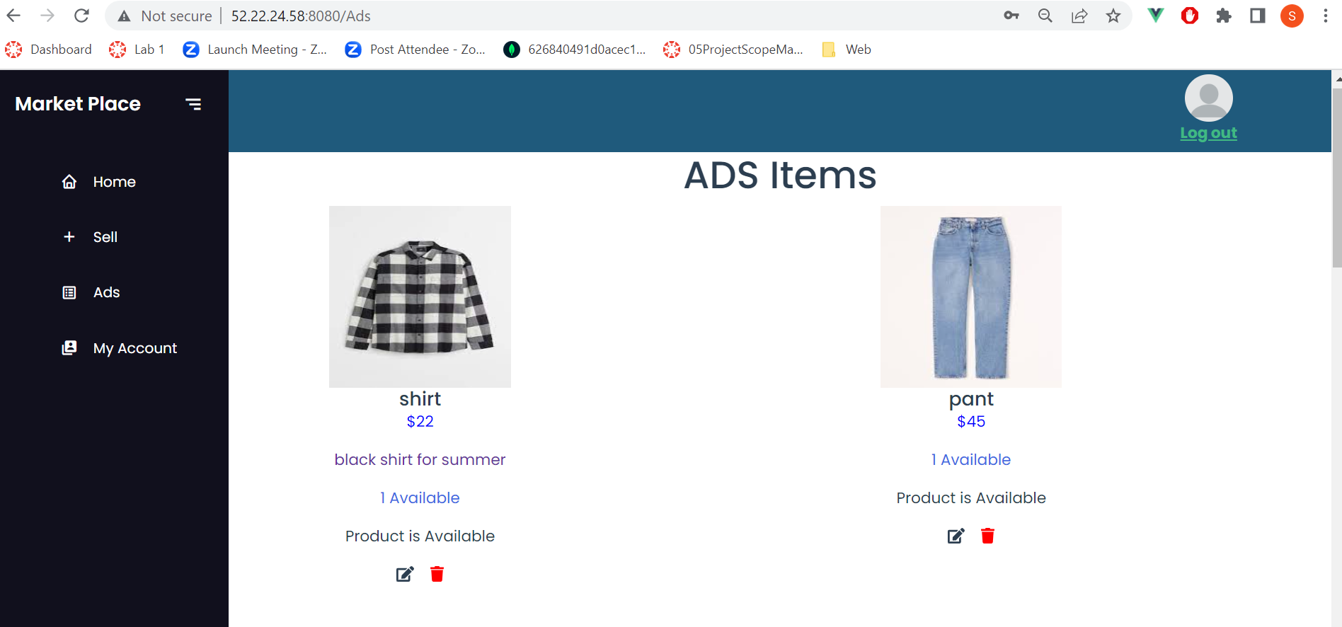
ADS FUNCTIONALITY
Products uploaded by a particular user are displayed
Product can be either updated or deleted
Fig 6. ADS Page
Usha Pati

Slide 12
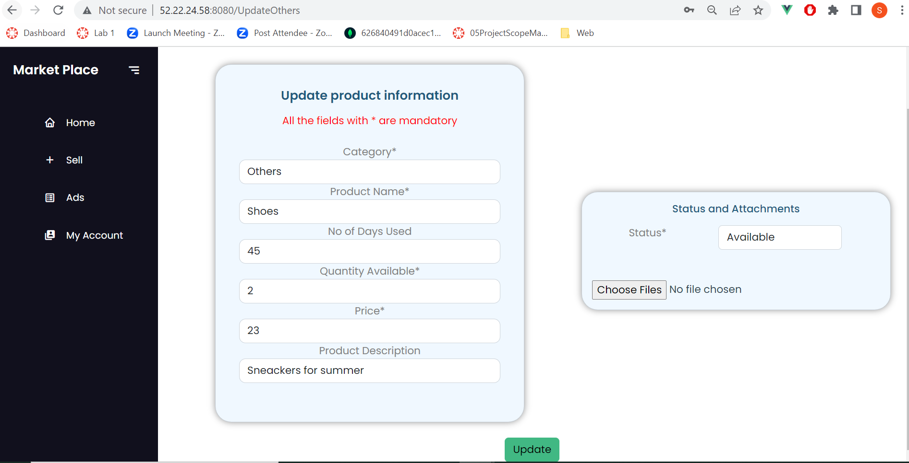
UPDATE FUNCTIONALITY
Product information can be updated
Status of the product is updated, either Sold or Available
Fig 7. Product Update Page
Usha Pati

Slide 13
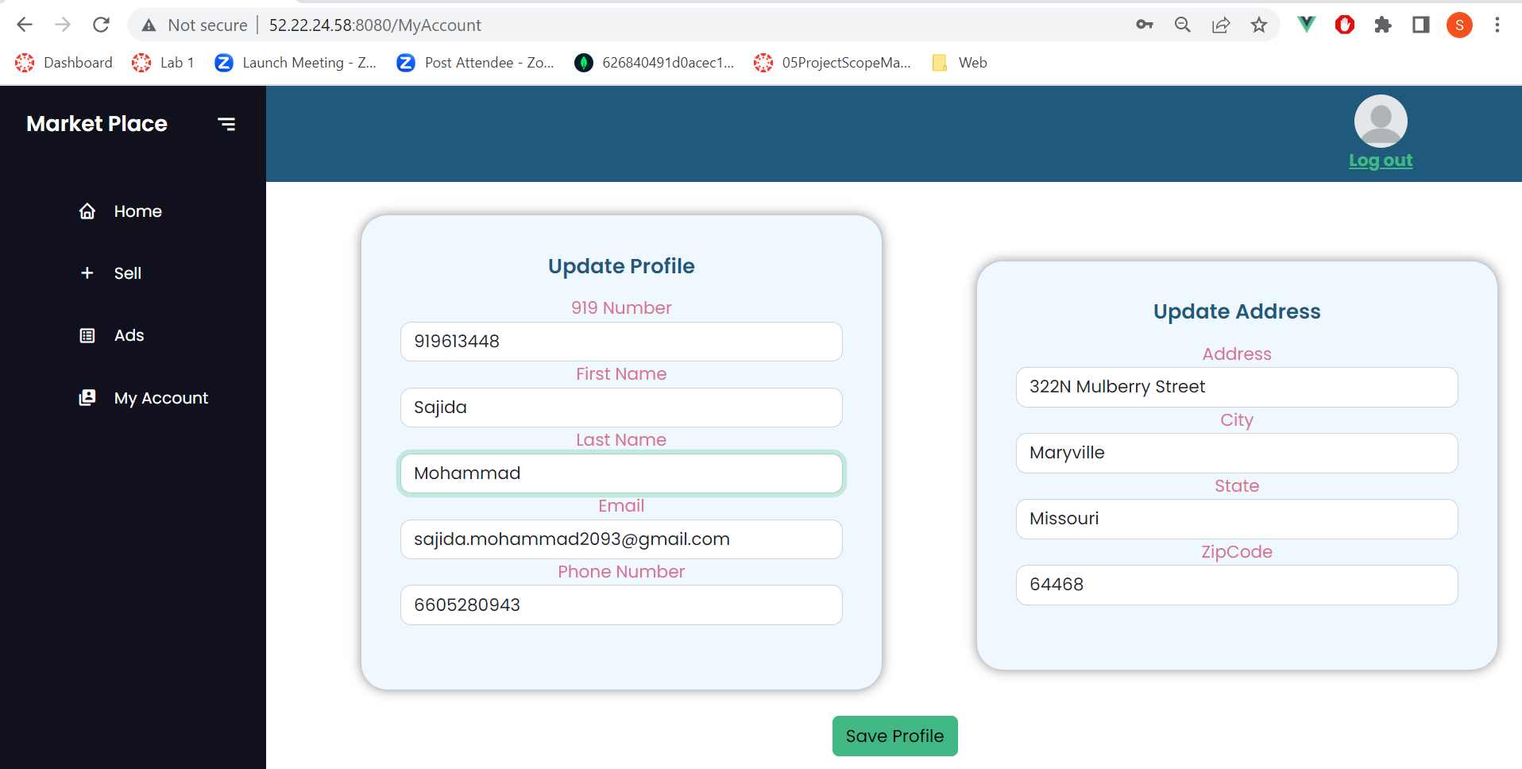
UPDATE PROFILE
Fig 8. User Profile Update Page
Usha Pati

Slide 14
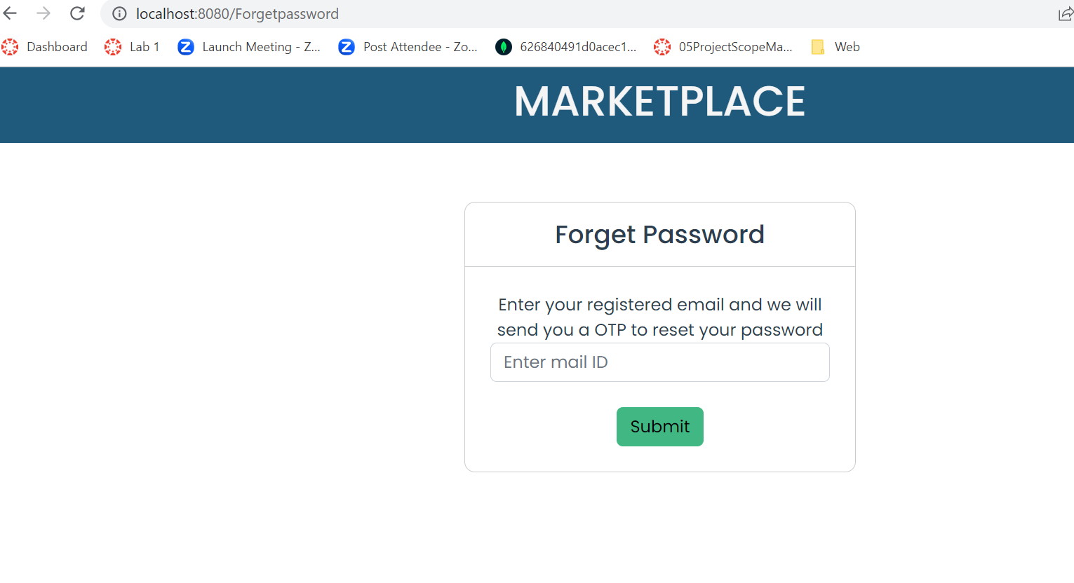
PASSWORD RESET
Fig 9. Password Reset Page
Usha Pati

Slide 15
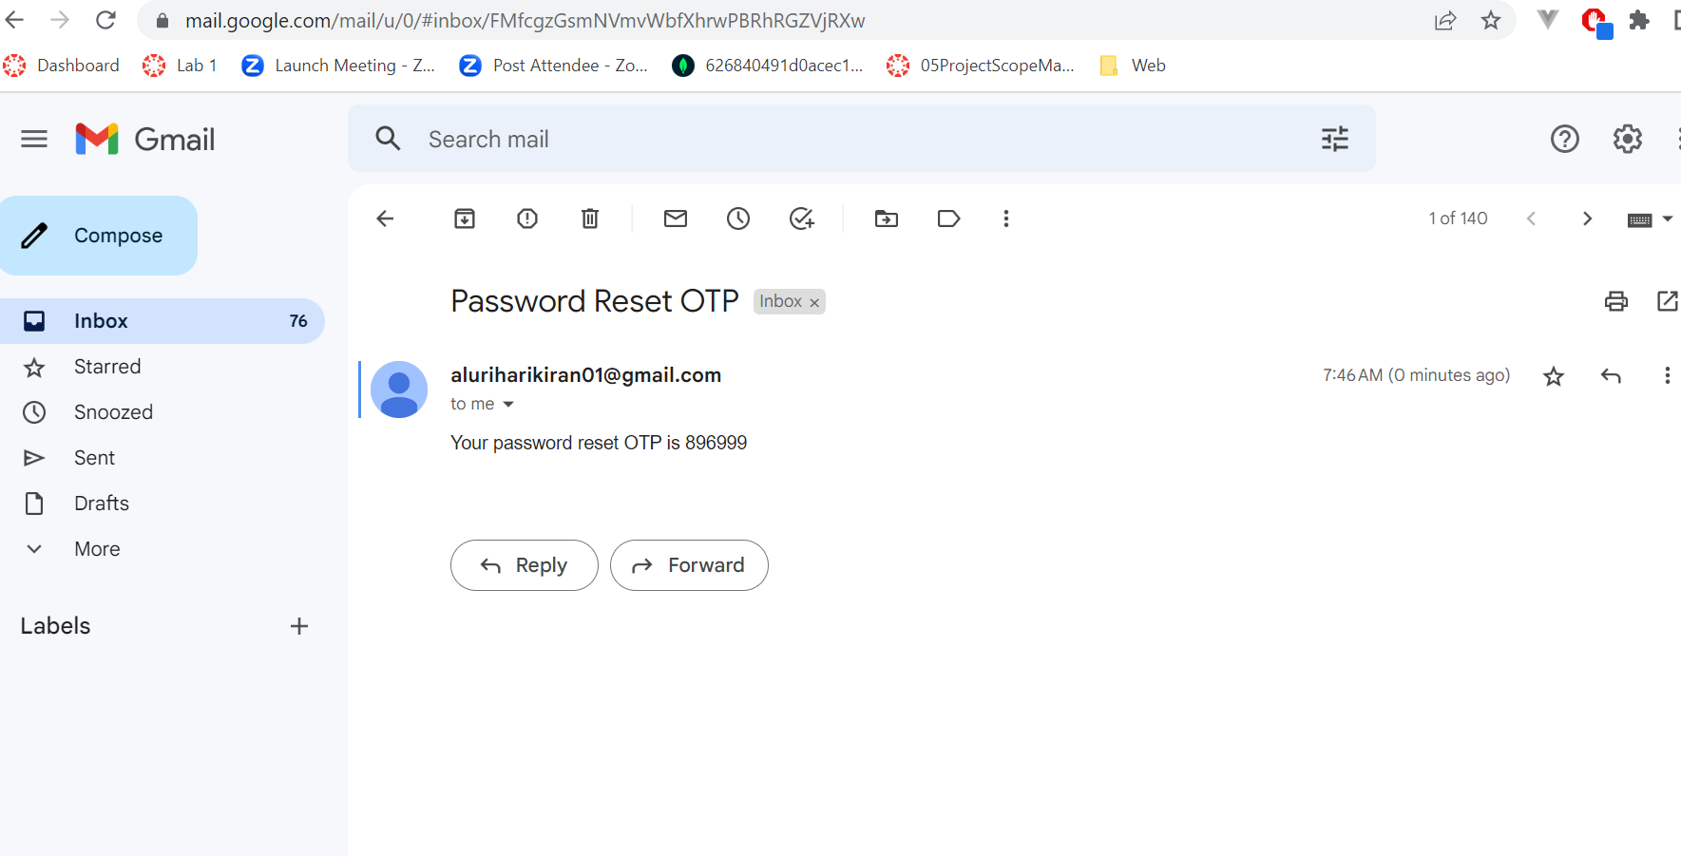
EMAIL NOTIFICATION
Fig 10. Email for OTP
Usha Pati

Slide 16
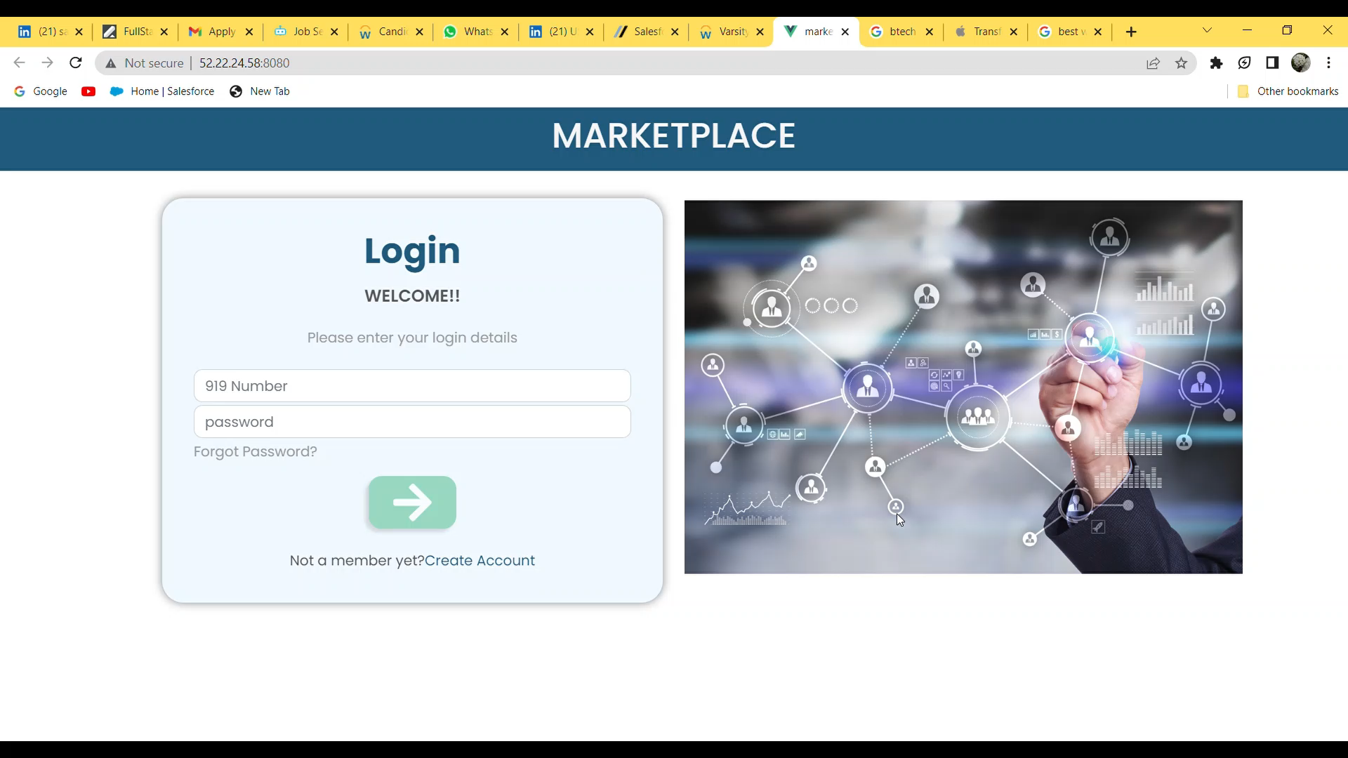
APPLICATION DEMO
Usha Pati

Slide 17
LESSONS LEARNT
Learnt how to use amazon AWS services like s3 bucket, EC2 instance and RDS
Had a temporary hold on the amazon account as the keys are exposed publicly
Issues when deploying the front-end due to the icons
Unable to receive OTP on user accounts due to google security configurations on the mail
Enabled two-step verification and generated app password
Sajida Mohammad

Slide 18
SUMMARY
Develop a web application where Northwest students/faculty purchase and sell products
Used spring boot, Amazon RDS and Vue in building the application Marketplace for pre-owned products
This application helps for both buyers and sellers to buy and sell pre-owned products
Sajida Mohammad

Slide 19
REFERENCES
Git Link : https://github.com/harichowdary-aluri/gdp_1-project
Vue: https://vuejs.org/guide/essentials/application.html
Spring boot: https://docs.spring.io/spring-boot/docs/current/reference/html/
Thankyou: https://tenor.com/view/ag-gif-23592893
Any Questions: https://tenor.com/view/anybody-have-any-questions-michael-south-park-s16e6-i-should-have-never-gone-ziplining-gif-23121301
Sajida Mohammad

Slide 20



Slide 21
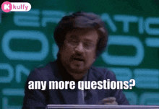

Slide 22
MARKET PLACE FOR NORTHWEST One place to buy and sell
APP URL: http://52.22.24.58:8080/
Dr. Chandra Mouli Kotteti – Client/Mentor Kiran Kumar Gundapuneni – Back End Developer Hari Kiran Aluri – Back End Developer Sajida Mohammad – Front End developer Usha Pati – Front End Developer

Slide 23
TEAM MEMBERS
DR.CHANDRA MOULI
KOTTETI
KIRAN KUMAR
GUNDAPUNENI
HARI KIRAN ALURI
SAJIDA MOHAMMAD
USHA PATI

